Slide 1
Partner Asset Guidance
Surface Hub 2S Solution Guide
Surface Hub 2S enables teams to collaborate no matter where they work from, helping dissolve the boundaries between remote and in-office work and keeping people, ideas, and data safe and secure. These assets, help customers and partners learn how to keep their data safe and solve he challenges employees face in the hybrid workplace.
How to use the Surface Hub 2S Solution Guide assets
The Surface Hub 2S Solution Guide includes four assets: a Solution Guide, digital flyer, an email template, and digital social post assets. Each asset has white space included to make room for partner branding. CTAs can also be edited, as they currently direct the audience to the guide download.​ The solution guide will need to be hosted locally and any CTA’s will need to be updated with the new URL that points to the newly hosted solution guide.
1. Solution Guide: Using Surface Hub 2S and Microsoft 365 in the hybrid workplace.
Objective: To convey the value of Microsoft Surface Hub 2S and Microsoft 365 products as a solution for many challenges faced by organizations in the midst moving to a hybrid workplace
Format: PDF and Adobe InDesign​
Editing tips Please use the associated AI file and edit assets in a compatible program (like InDesign).
2. Digital flyer: Explore the benefits of using Microsoft Surface Hub 2S.​
Objective: To convey the value of Microsoft Surface Hub 2S and Microsoft 365 products to enterprises in a quick, easy-to-digest way
Format: PDF and InDesign​
Editing tips Please use the associated AI file and edit assets in a compatible program (like InDesign).
3. Email template: Explore the benefits of using Microsoft Surface.​
Objective: To introduce challenges organizations are facing and drive to the solution guide where the audience can learn how Microsoft Surface Hub 2S and Microsoft 365 products can address these challenges
Format: OFT.
Editing tips To build the OFT email, choose the OFT file from the eMail Templates folder. Add the name of the recipient and your name in the introductory paragraph. Add your email address to the “Contact me” link at the bottom of the email. For the email template, edits must be made in a Microsoft Office-compatible program (like Microsoft Outlook).
​
4. Digital social assets: Two creative assets , one animated and one static, built for use on social media platform LinkedIn.
Objective: To convey the value of Microsoft Surface Hub 2S and Microsoft 365 products in a manner conducive to social media that is shareable and entices the audience to learn more
Format: AI, PSD, XD, PNG, and MP4
Editing tips: Digital social assets will need to be edited in a tool like Adobe After Effects.
Note: Use image copy provided when posting to social media
© 2020 Microsoft Corporation. All rights reserved. This document is provided “as-is.” Information and views expressed in this document, including URL and other Internet Web site references, may change without notice. You bear the risk of using it. This document does not provide you with any legal rights to any intellectual property in any Microsoft product. You may copy and use this document for your internal, reference purposes.
https://www.microsoft.com/en-us/surface/business

Slide 2
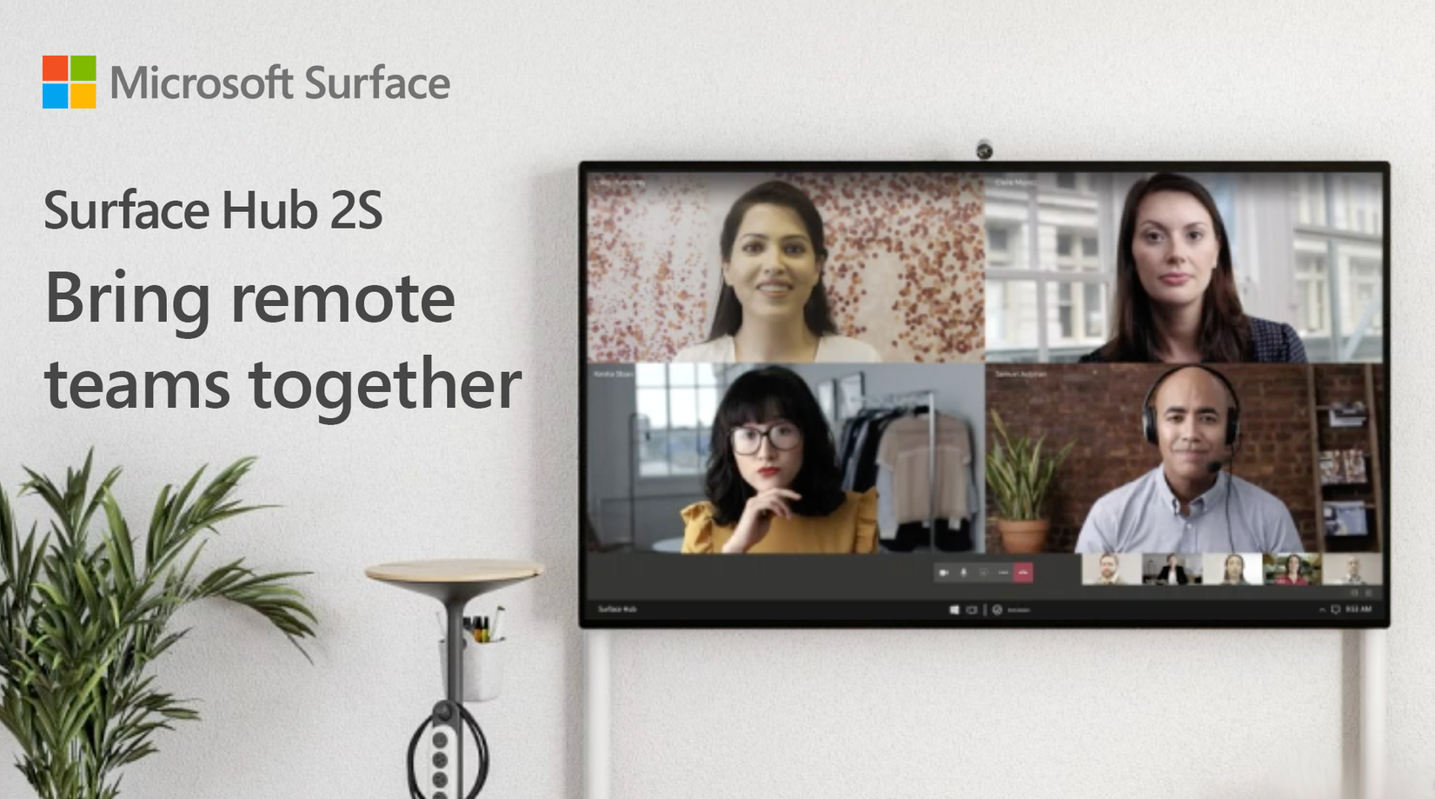
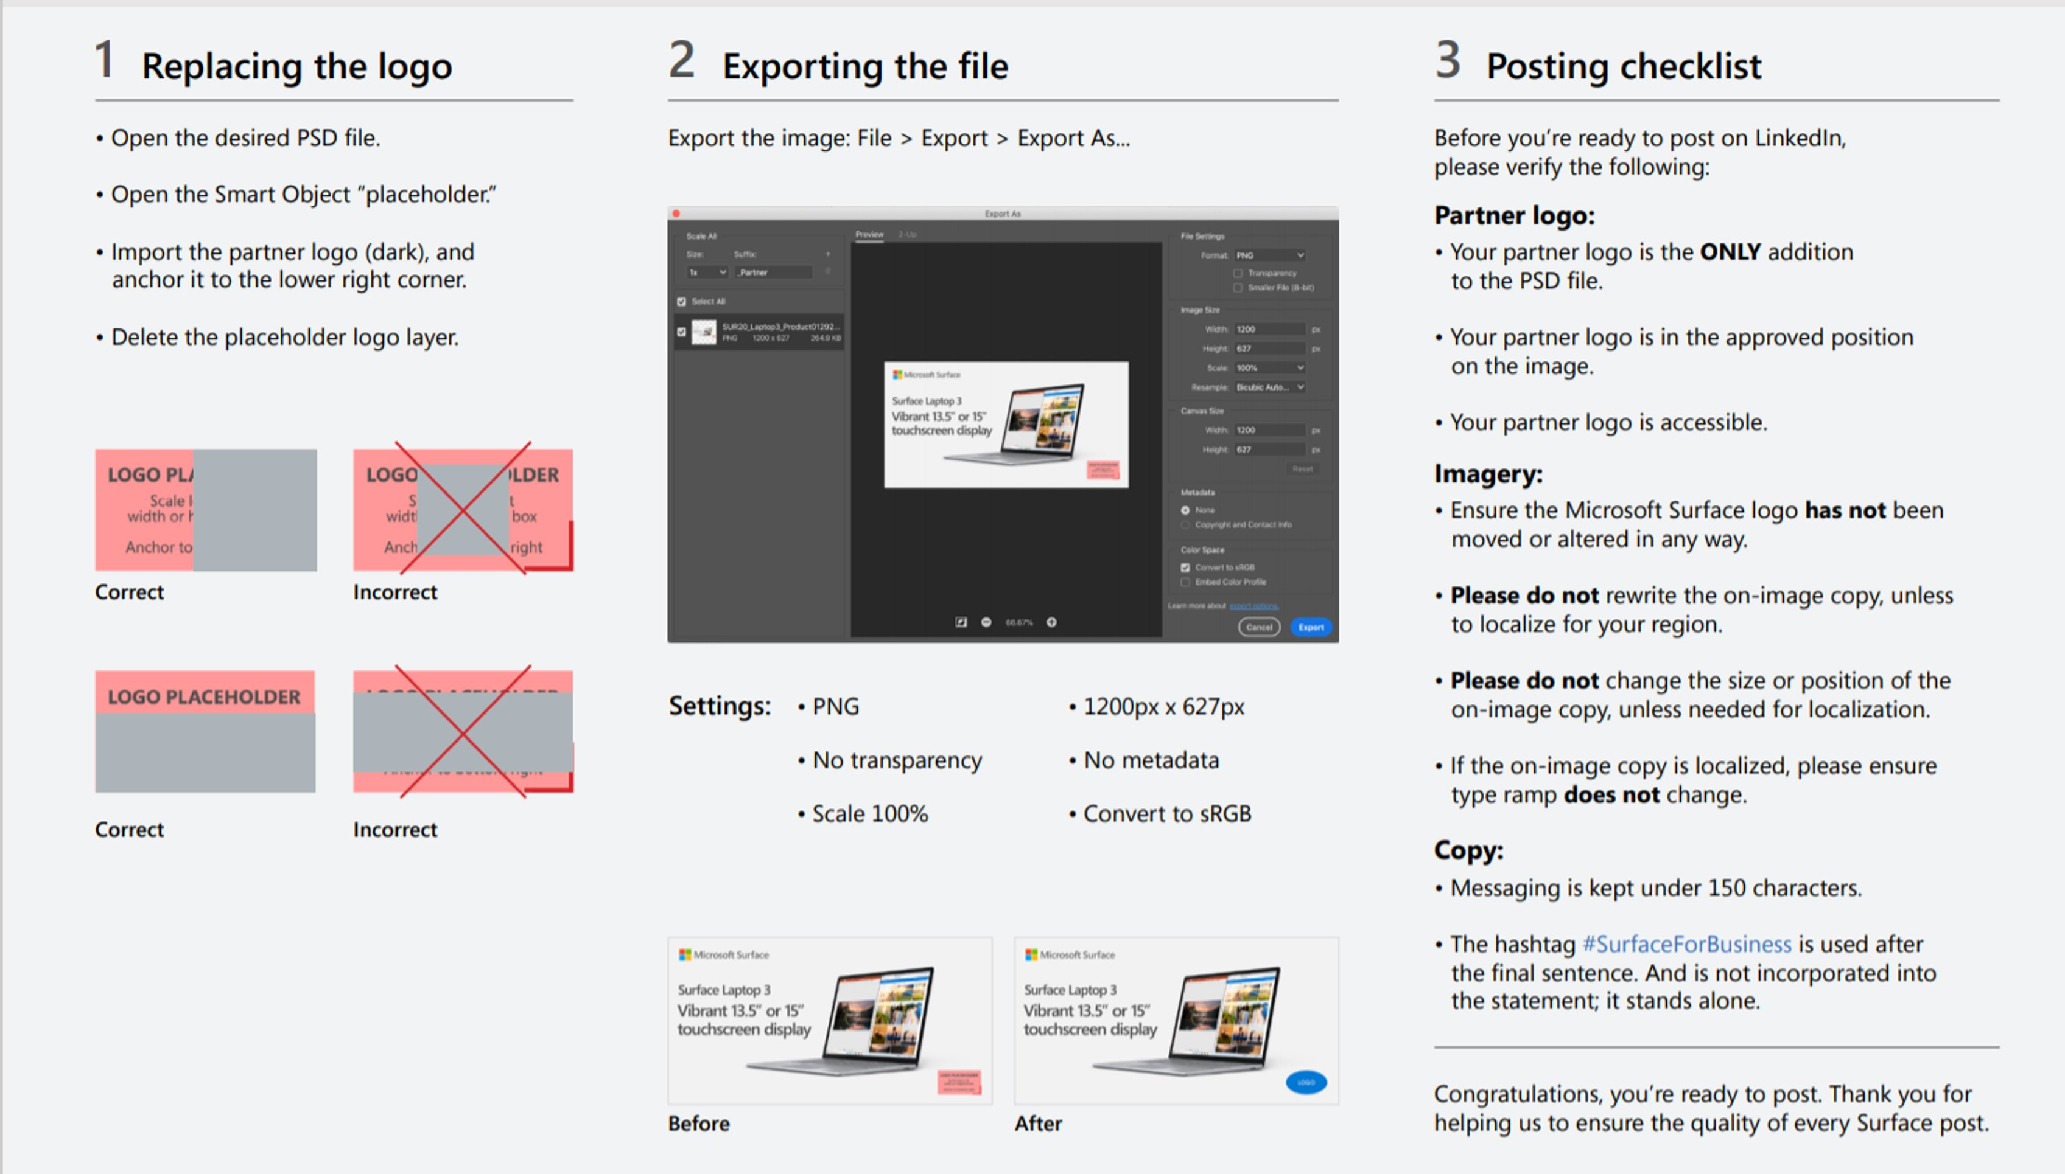
Instructions for how to build your social post
All social posts were built for use on the LinkedIn platform. These social posts can be leveraged for use on owned and operated (O&O) LinkedIn, Facebook, and Twitter handles given that they have similar spec requirements. Approved social copy and links to the assets are outlined below. When posting to O&O social media channels, use the copy in the copy grid that corresponds to the approved imagery and link to the Surface Hub 2S Solution Guide (which will need to be hosted locally.)
_{Asset Location + Title} | _{Thumbnail} | _{File type} | _{Post copy} | _{CTA}
Social product post | Surface Hub 2S Bring remote teams together |  | PNG | Bring teams together in your hybrid workplace and make any place a teamwork space with Surface Hub 2S. Empower your employees to collaborate better together. #SurfaceForBusiness | Read our solution guide: Surface Hub 2S in the hybrid workplace
To come |  | MP4 | Bring teams together in your hybrid workplace and make any place a teamwork space with Surface Hub 2S. Empower your employees to collaborate better together. #SurfaceForBusiness | Read our solution guide: Surface Hub 2S in the hybrid workplace
Instructions on how to add your partner logo

Slide 3
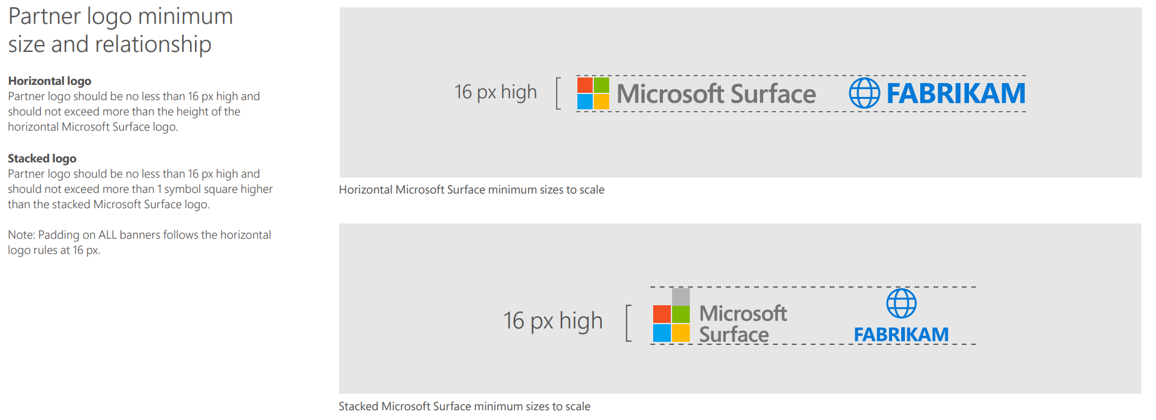
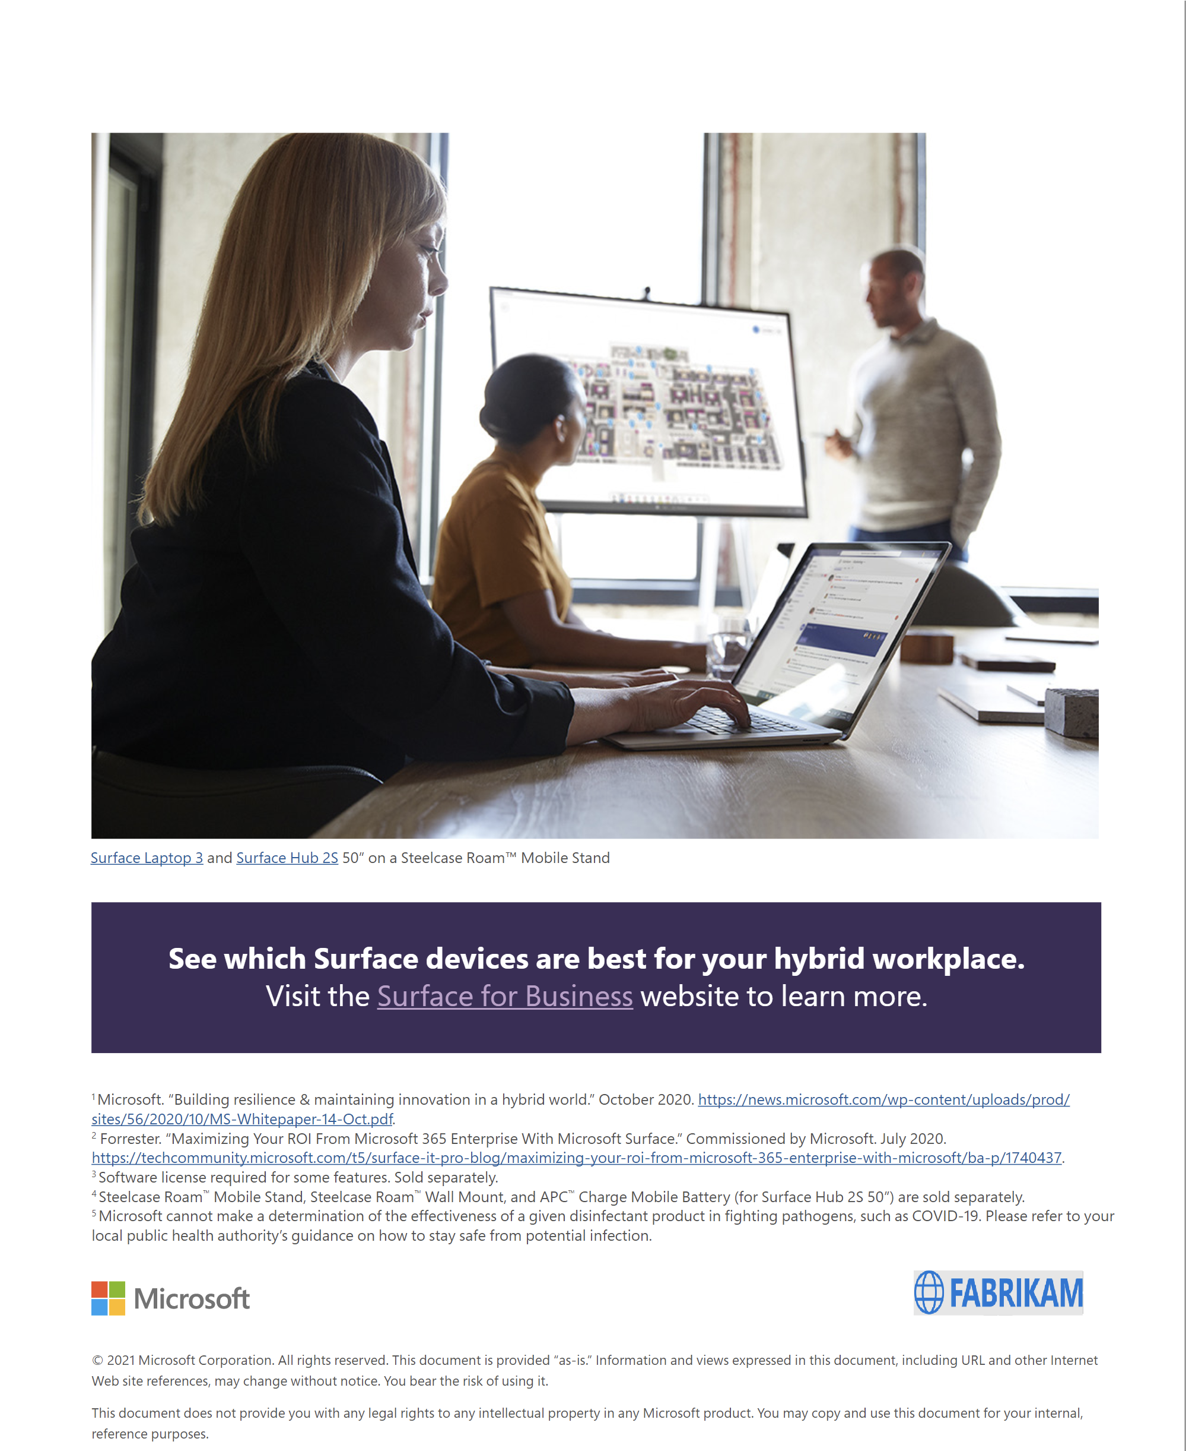
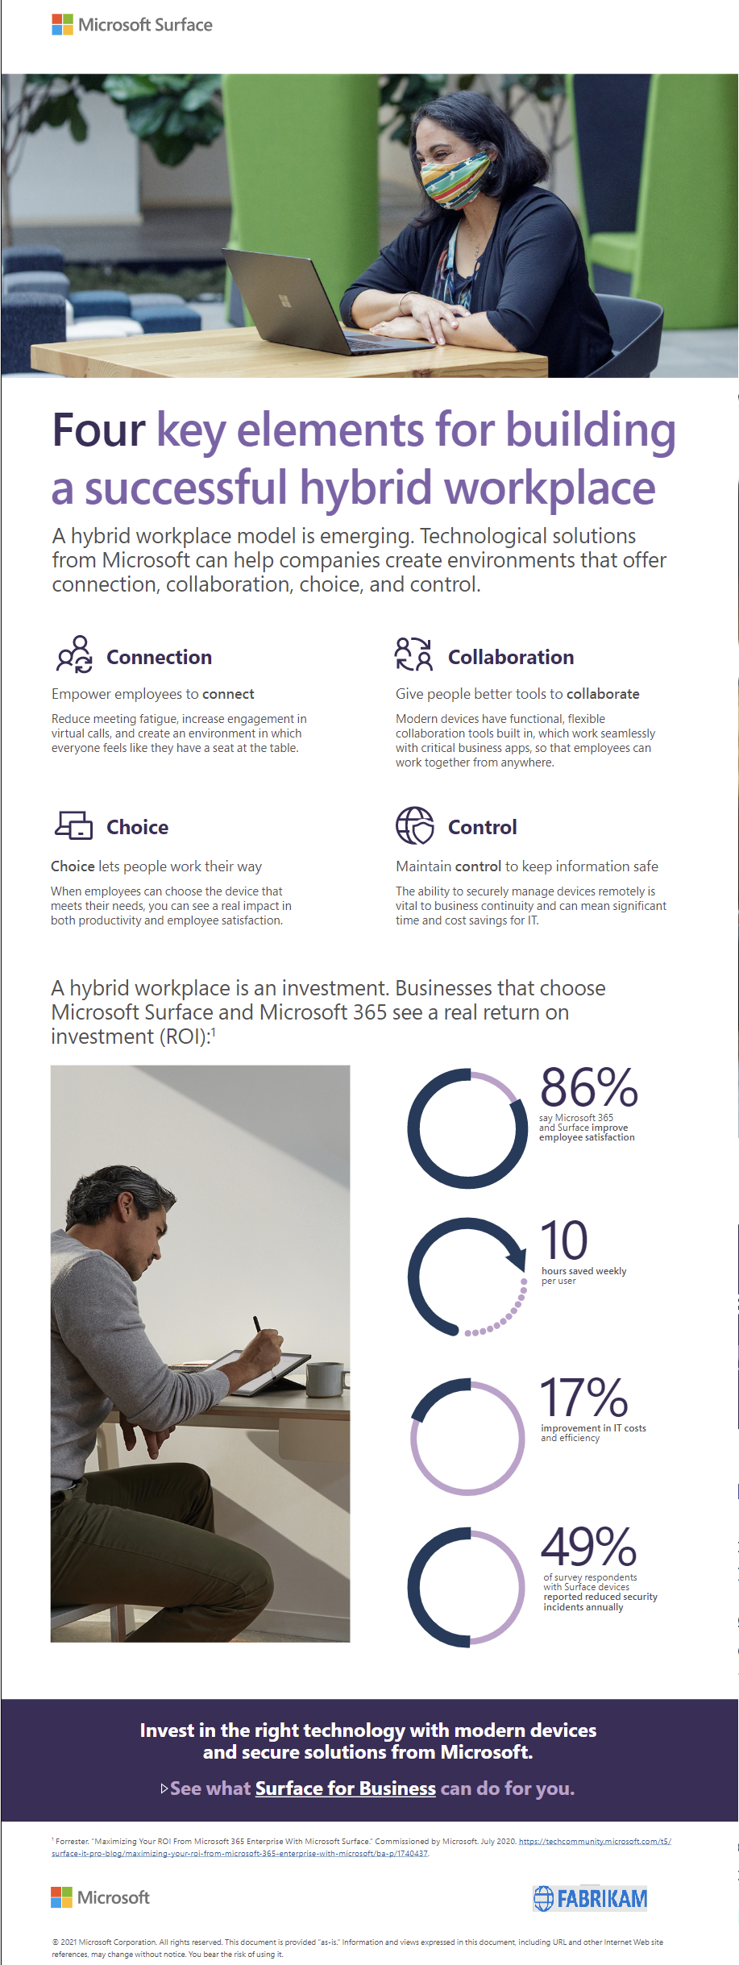
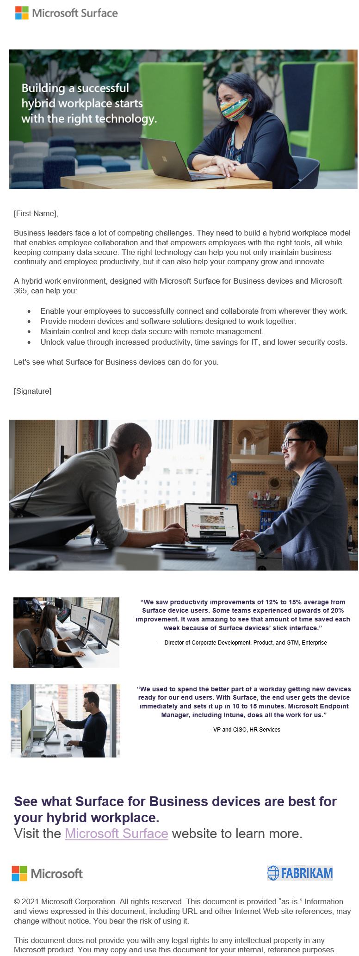
Co-branding eBooks, emails & flyers
A partner logo can be added to the bottom left corner each asset using the guidelines below.
Shown for example only
eBook
infographic
email

